Slide 1

Fitbit Dataset Use Case by Group 5

Slide 2
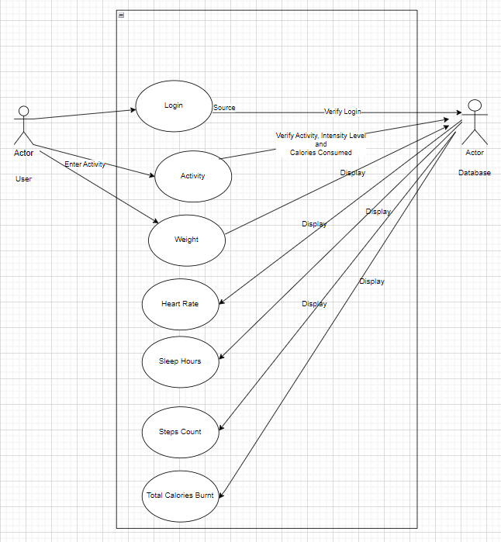
Fitbit Dataset Use Case
Actors:
User: Represents the person who wears the Fitbit device and interacts with the online Fitbit mobile application.
Database: Represents the backend relational data storage and management system for the data collected by the Fitbit device and through user input.
Use Cases:
Login: Allows the customer to log on to the mobile application.
Verify Login: Enables the database to validate the user log in request.
Enter Activity: Allows the customer to view heartrate, sleep, steps, intensities and calories burnt information and enables them to enter weight and activity information in the mobile application.
Verify Activity and Intensity Level: Allows the database to verify the activity, intensity level and calories burnt information entered by the user.
Display: Allows the database to return data for displaying on the mobile application.

Slide 3
Fitbit Dataset – Extended/New Feature
Feature Name: Activity Logging
Method: Manual
Initiating Actor: User
Use Case: Currently the Fitbit device sensor collects the heartrate, sleep, intensities, steps and calories data and pushes into the database. As a part of the new feature, the user will be able to manually create a new activity, define its possible intensity levels and the corresponding calories burned per minute into the mobile application. This would allow the user to track activities besides the step count during the day.
New Tables Supporting the Feature:
activity_log_daily
activity_master
activity_intensity_master

Slide 4

Business Rules
A user cannot log data without pairing a device to the application.
The user cannot log an activity if it does not exist without creating it first.
One user account is associated with only one device.
One device will have many sleep, steps, and calories records with timestamps in minutes.
One device will have many heart rate records with timestamps in seconds.
One device will have zero to many activity records per day.
Weight must be entered in either Kilograms or Pounds.
The user cannot log an activity without defining the intensity level and calories burned for that activity.
There must be at least 1 intensity level defined for each activity. One activity can have one or many intensity levels.
New Feature

Slide 5
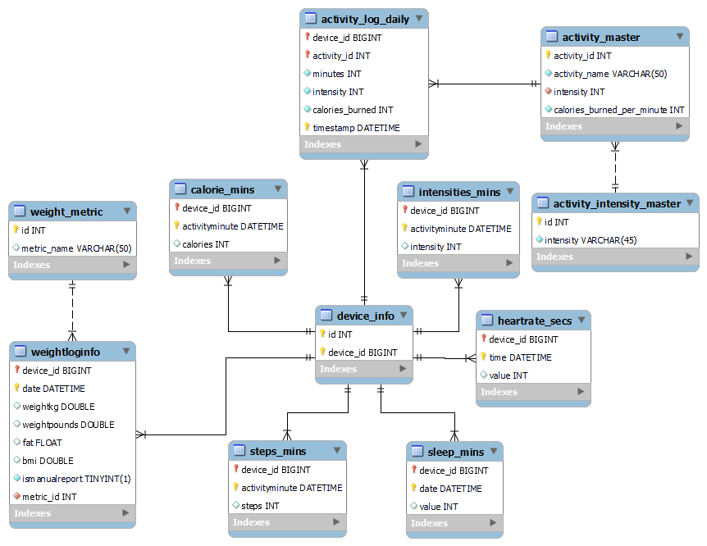
Entity Relationship Diagram

Slide 6
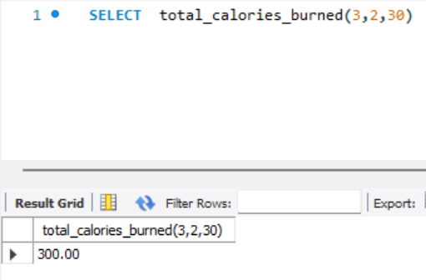
Other Schema Objects - Function
Name: total_calories_burned
Input Parameters: activity_id INT, intensity INT, minutes INT
Output: total_calories_burned DECIMAL(10,2)
Use Case: The user enters his activity, intensity of the activity and the number of minutes he spent doing the activity with that intensity in the application. The table activity_intensity_master stores the information for calories burned for every activity for different intensity levels. This function returns the calculated value of total number of calories spent on the activity for the given intensity and minutes.

Slide 7
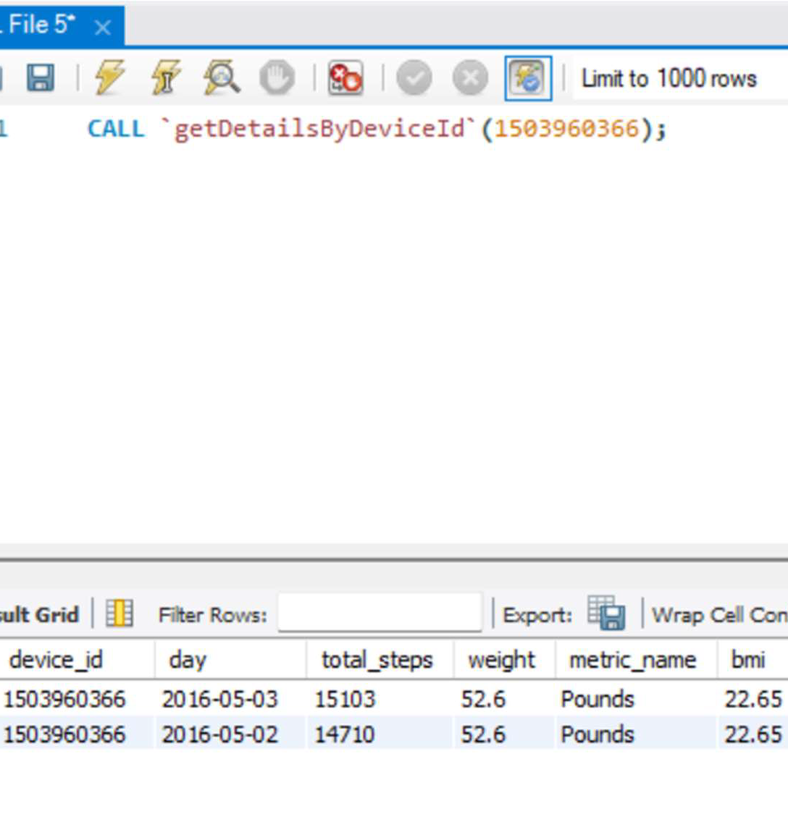
Other Schema Objects - Stored Procedure
Name: getDetailsByDeviceId
Input Parameters: device_id BIGINT
Output: Table with device_id, date, total_steps, weight, metric_name and bmi
Use Case: The device collects steps data every minute. This stored procedure returns the aggregated summary of steps taken during a given day, the latest weight, metric of weight and bmi for the device id passed as input parameter.

Slide 8
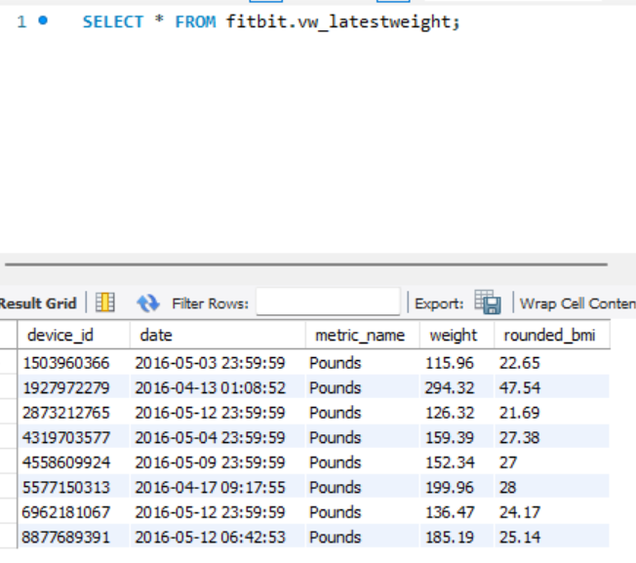
Other Schema Objects - View - 1
Name: vw_latestweight
Output: Table with device_id, date, metric_name, weight, rounded_bmi
Use Case: The user logs his weight on the mobile application. This view shows the latest weight for each device_id with the date when it was logged on, the metric they were recorded in and the corresponding bmi rounded off to two decimals.

Slide 9
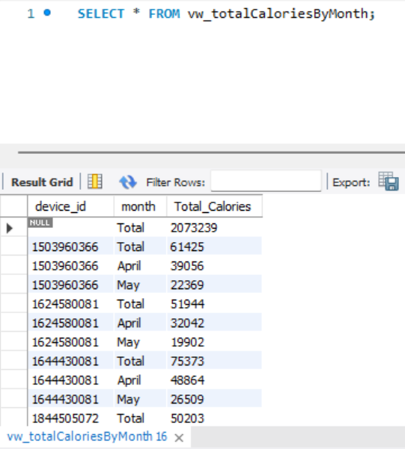
Other Schema Objects - View - 2
Name: vw_totalCaloriesByMonth
Output: Table with device_id, month, total_calories
Use Case: The device records calories burned by the wearer every minute. This view returns the total number of calories burned monthly for each device id.

Slide 10
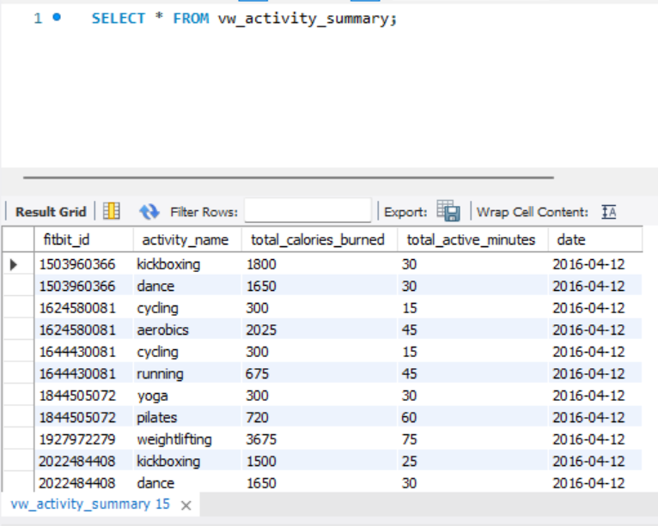
Other Schema Objects - View - 3
Name: vw_activity_summary
Output: Table with fitbit_id, activity_name, total_calories_burned, total_active_minutes and date
Use Case: The user logs his activities with intensities and the number of minutes spent doing the activity at the given intensity level. This view shows the summary with total minutes and calories burned by the user doing an activity each day.
For E.g., a user may do cycling at low intensity for warm up for 10 mins and 5 mins to cool down and at high intensity for 15 mins. There are different number of calories burned for different activities based on intensity levels. In this user’s case, the view will show total of 30 mins spent on cycling with total calories as (calories at low intensities * (10+5 minutes) + calories at high intensity * 15 mins)

